Slide 1
GIS PROJECT
GROUP MEMBERS:-
BHAGYASHREE MEHTRE
KEERTHIPRABA
P GEETHA

Slide 2
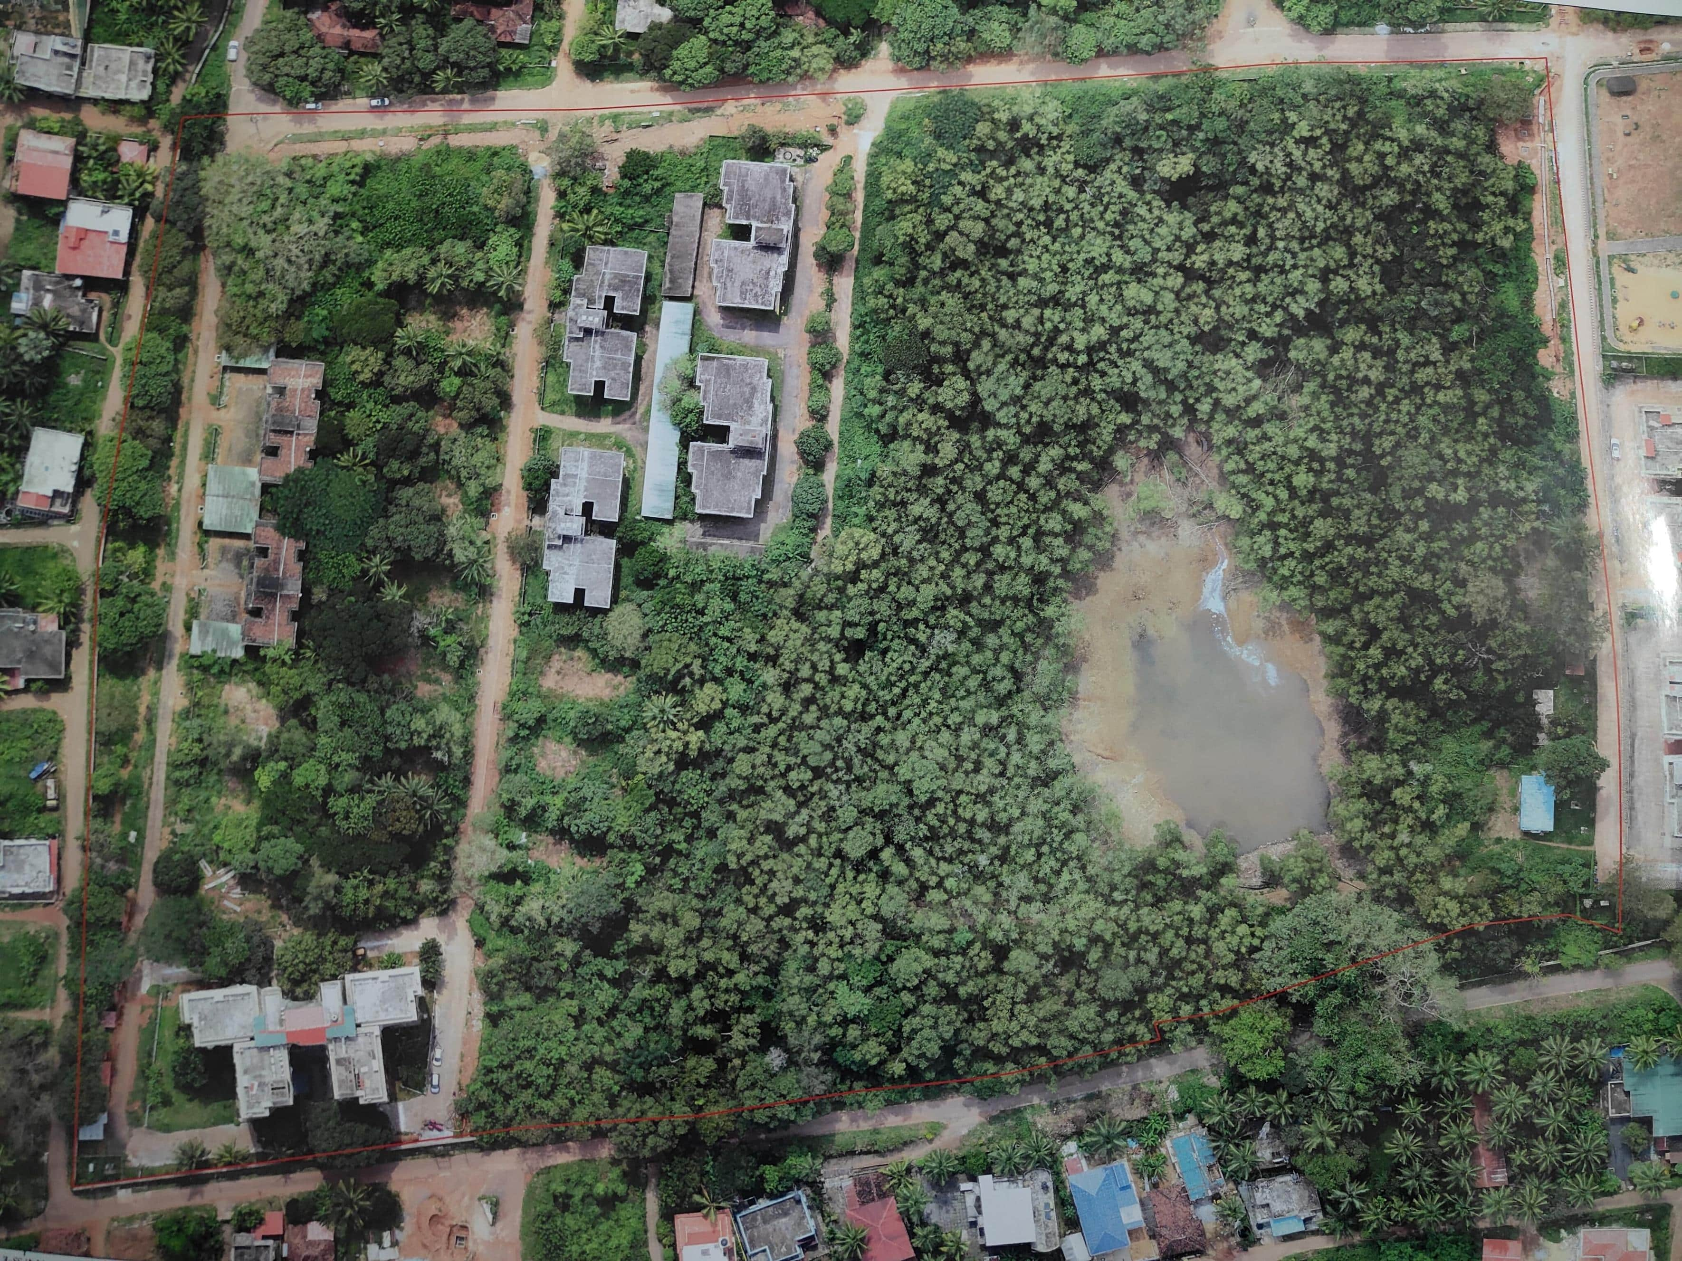
Allotted area

Slide 3
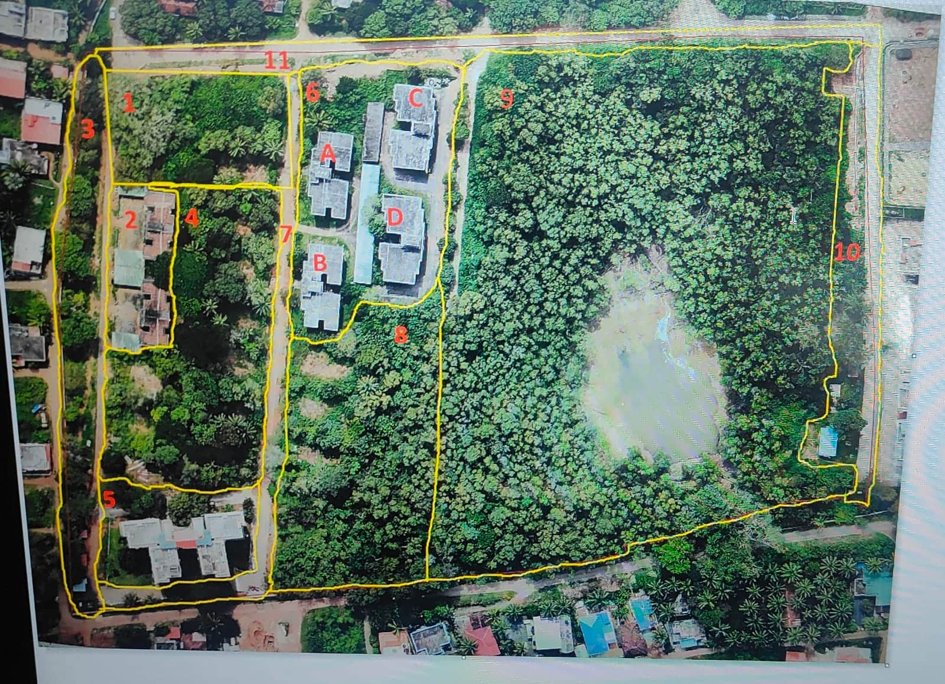
Allotted area in grid form

Slide 4
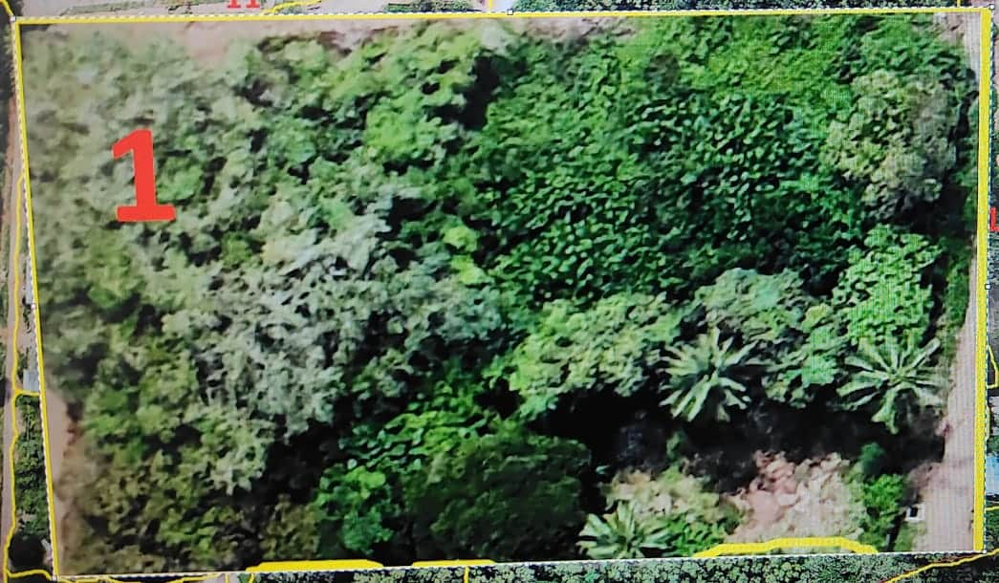
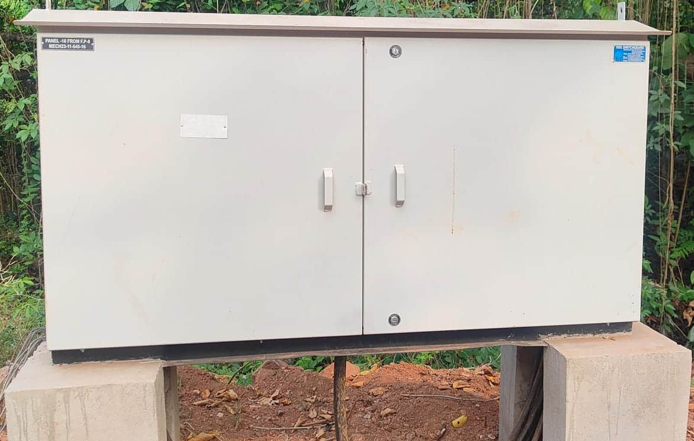
GRID 1
Perimeter = 204.77m
Area = 2563.44m
Waste area:-
perimeter = 55.71m
Area = 183.86m
Street light control panel:-
Dimensions = 45.7cm X 61cm
No.of trees = 8
Other plants = 30

Slide 5
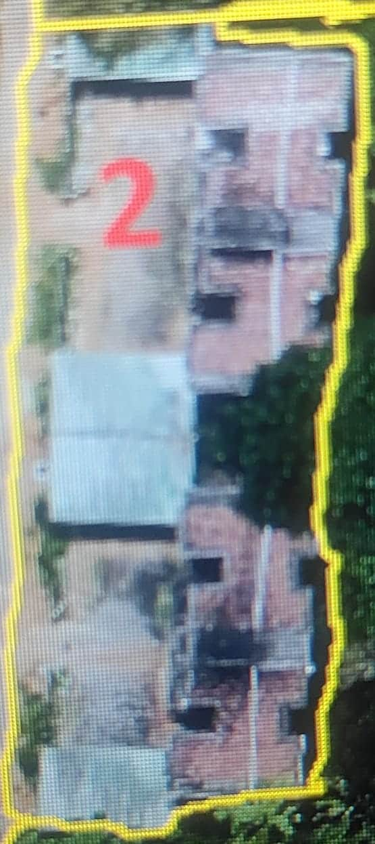
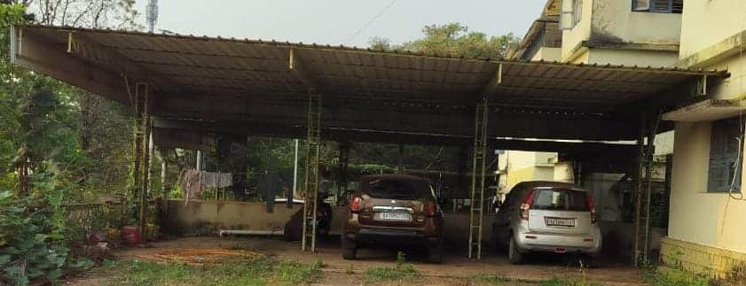
GRID 2
Perimeter = 153.46m
Area = 111.89 m^2
Parking areas:-
3 parking areas
Perimeter = 41.65m
Area = 103.03 m^2
Height = 2m
3 cars can be parked in 3 parking areas

Slide 6
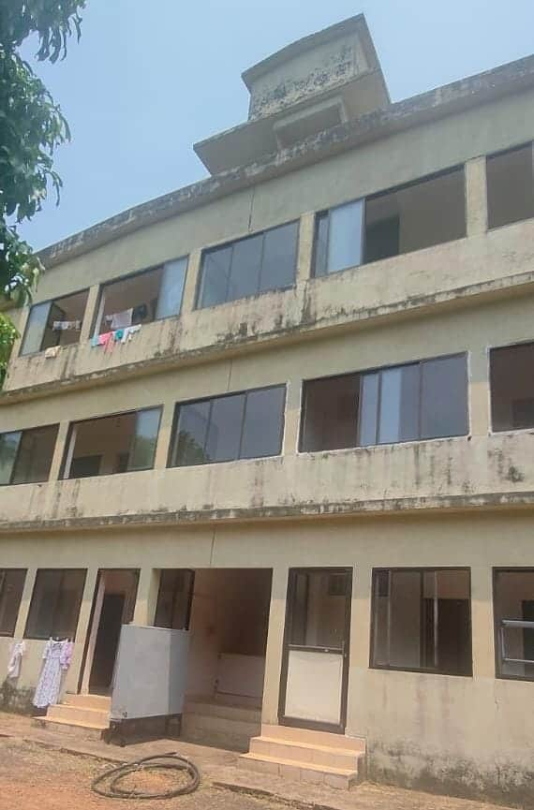
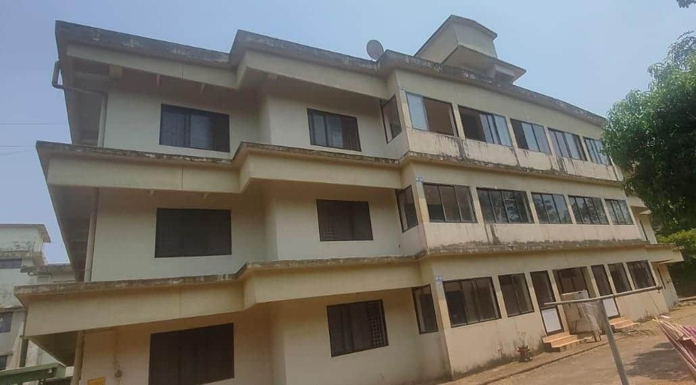
GRID 2
Building:-
2 buildings with 4 apartments
3 floors with 10 rooms
Perimeter = 54.44m
Area = 99.19 m^2
Height = 9m

Slide 7
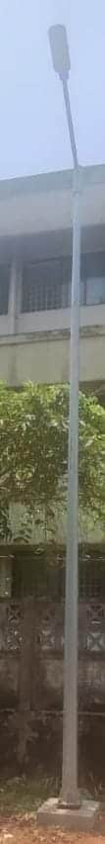
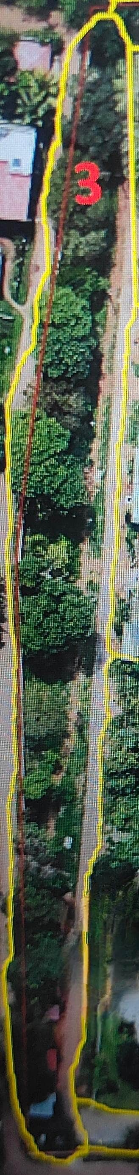
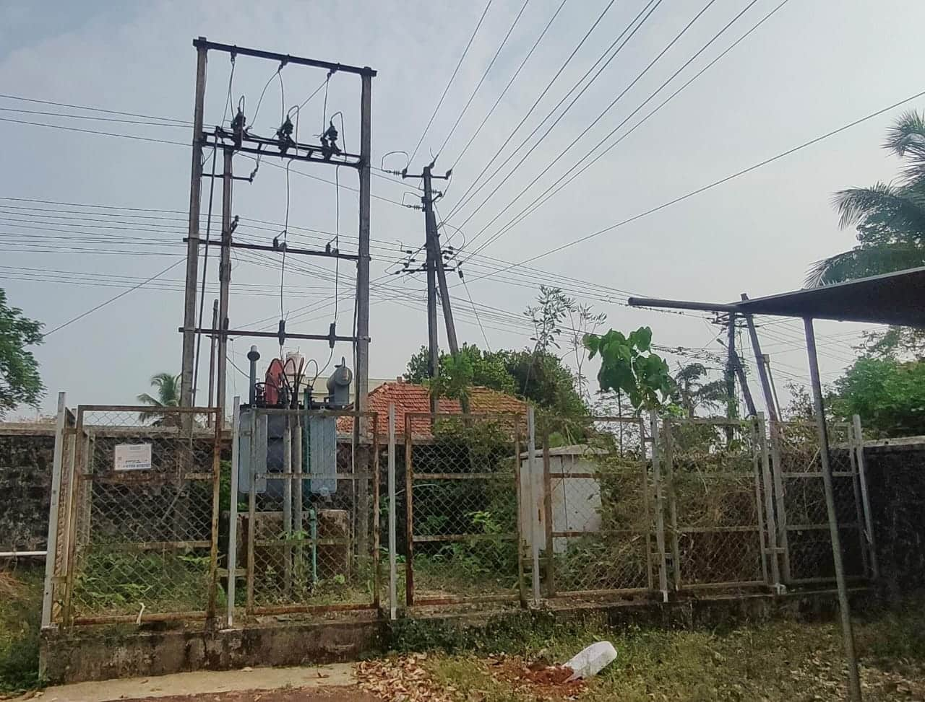
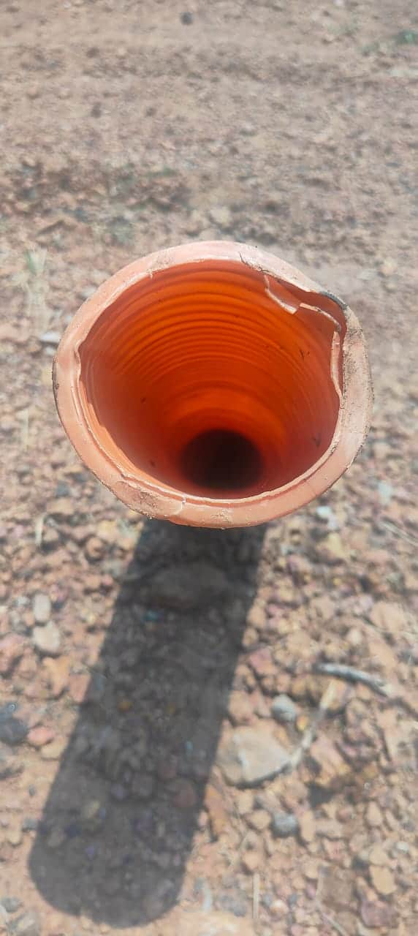
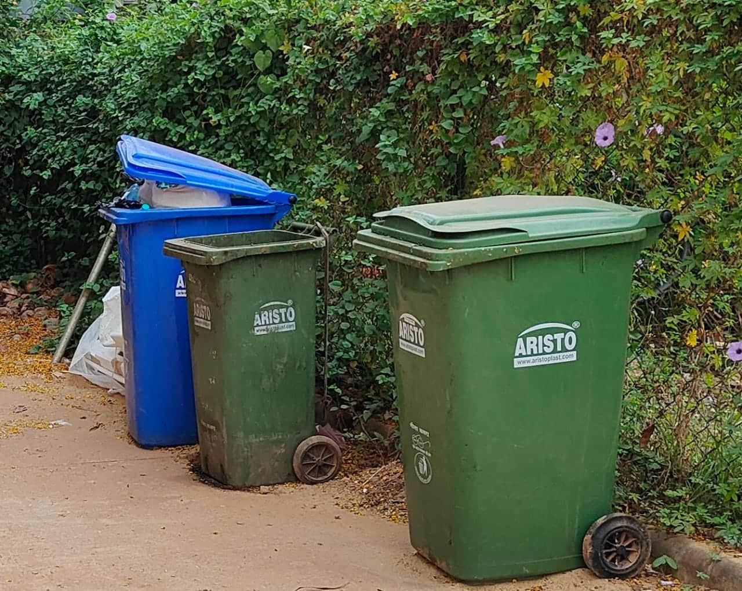
GRID 3
Area = 457.88m
Perimeter = 3302.53 m^2
5 concrete electricity pole with street lamp of compact fluorescent
No.of trees = 35
Other plants = 9
Dustbin spots = 2
Transformer = 1
Gas pipeline = 4

Slide 8
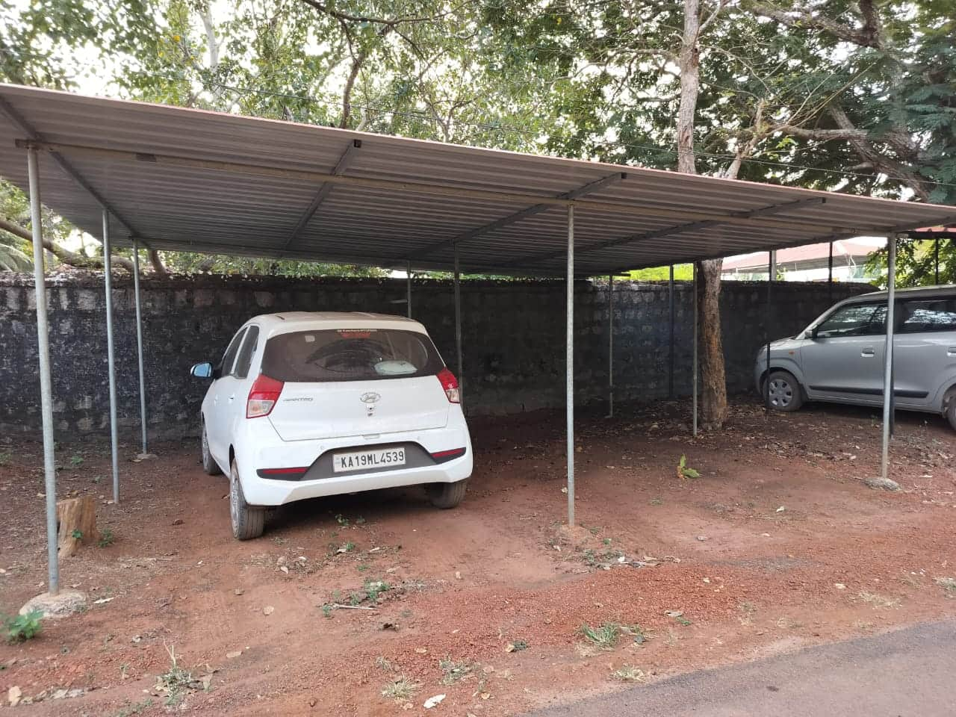
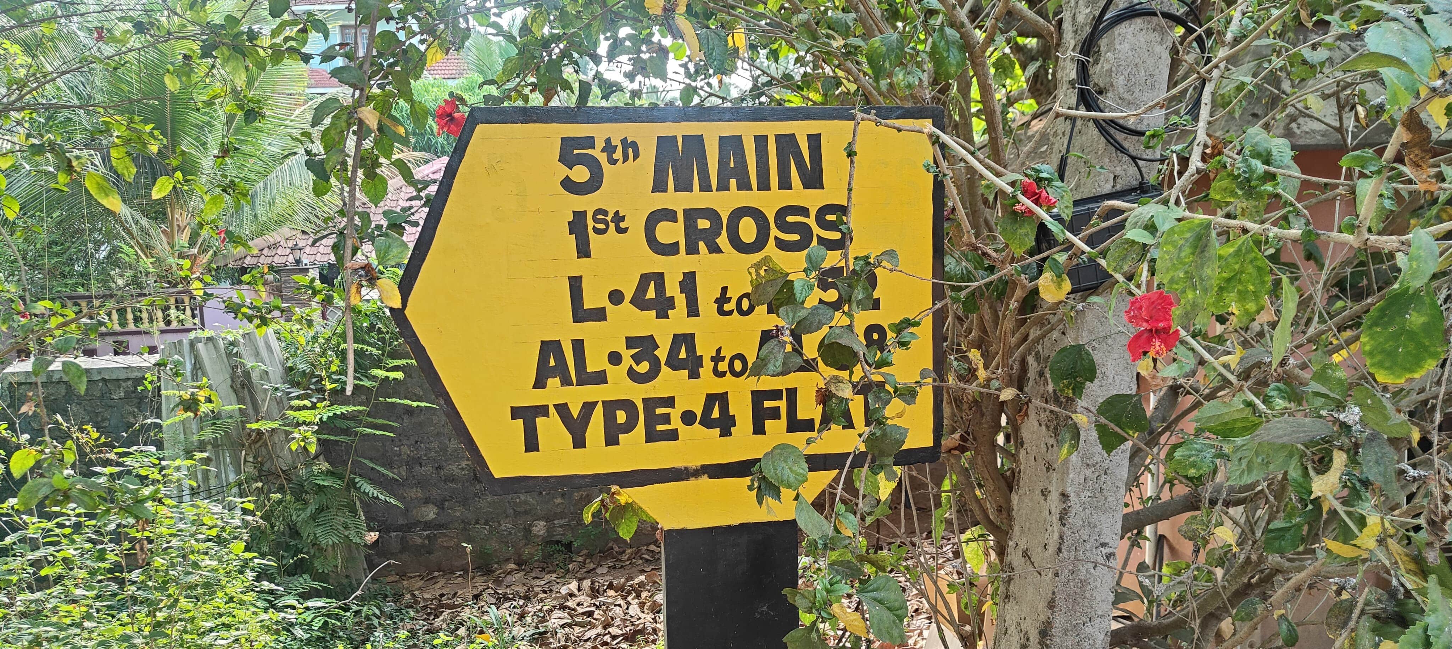
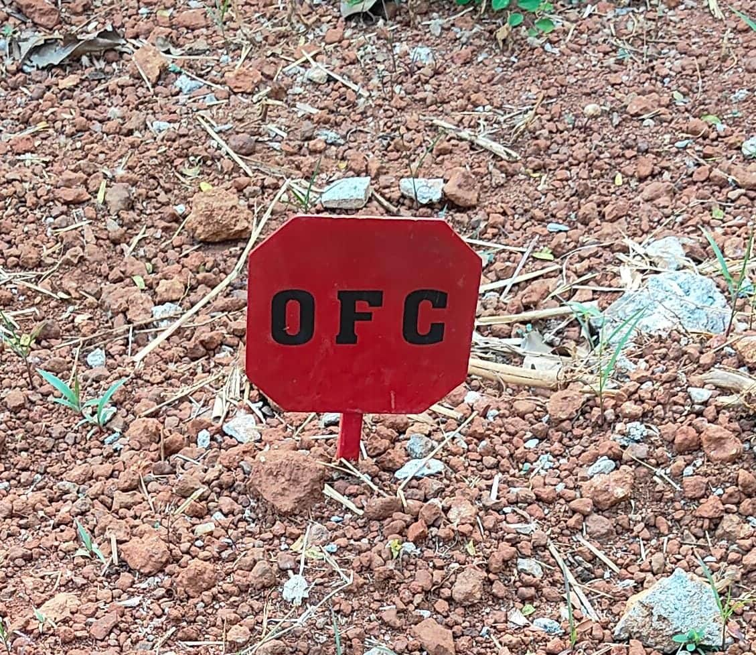
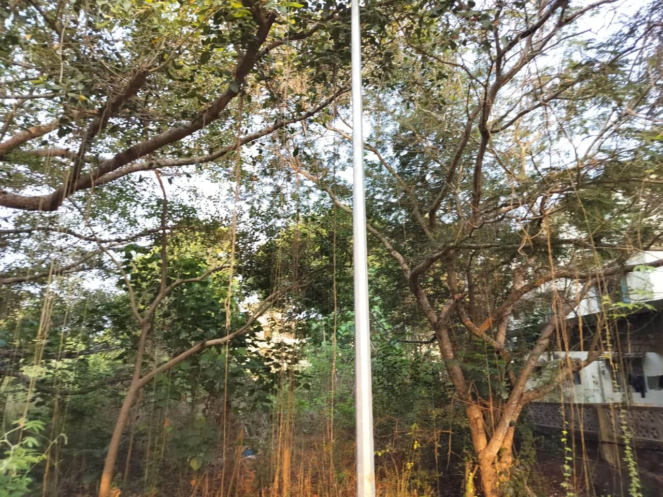
GRID 3
Parking area:-
9 cars can be parked
Area = 1331.5 m^2
Perimeter = 224.66m
Height = 2m
2 OFC(optical fibre cable)
1 concrete electricity pole without street lamp
Sign board with yellow background , black labelled and bordered

Slide 9
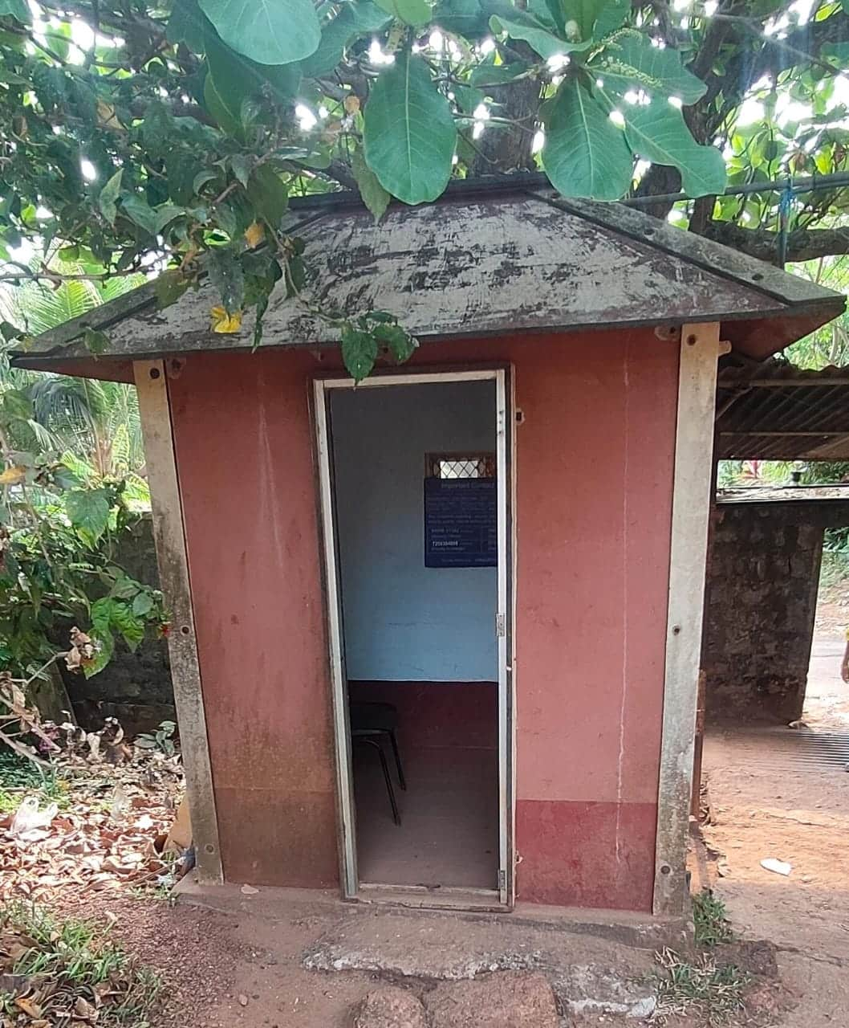
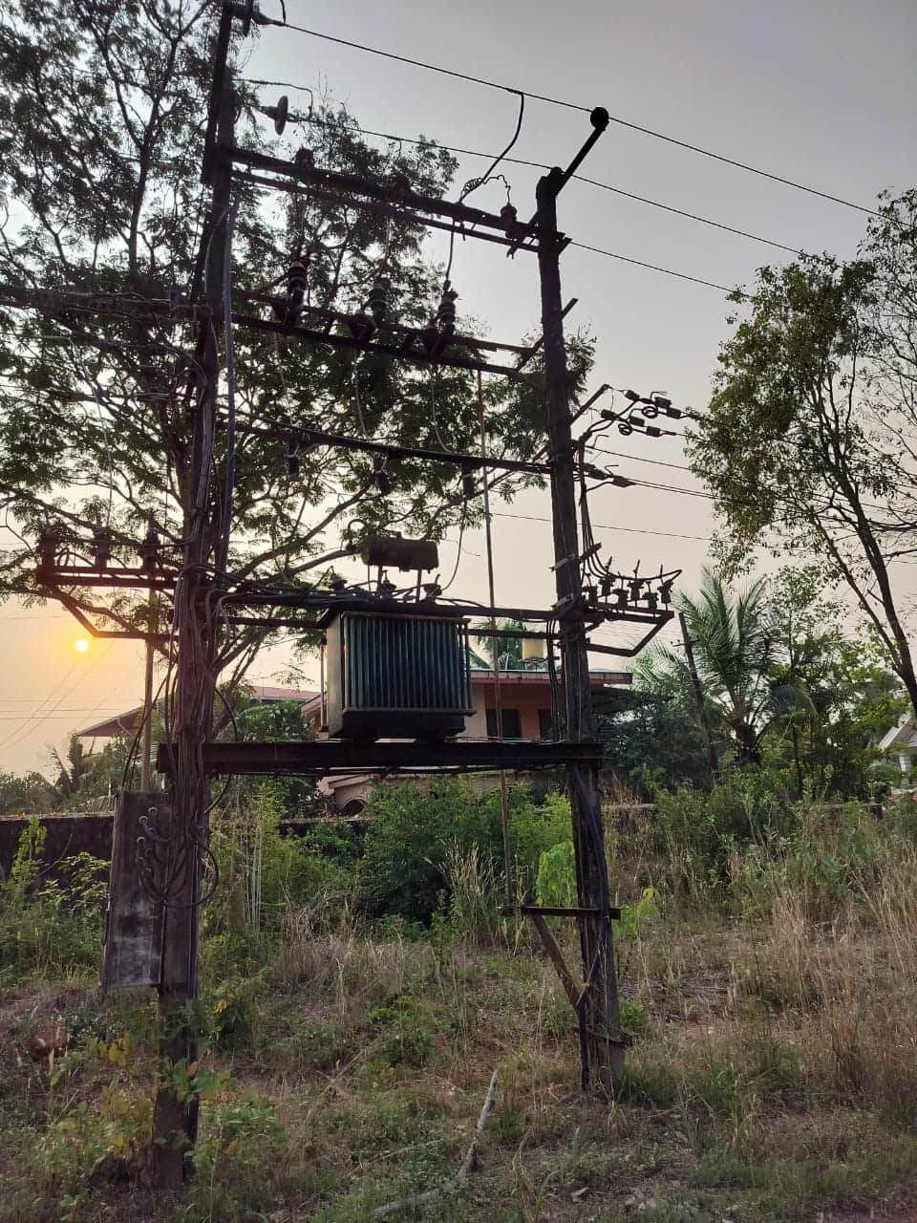
GRID 3
There is a electric transformer and distribution equipment.
The setup is enclosed within a fenced area for safety and security
Single lane road:-
Length = 203.39m
Width = 4.98m
Watchman sitting area:-
Perimeter = 21.2m
Area = 28.06 m^2
Height = 2m

Slide 10
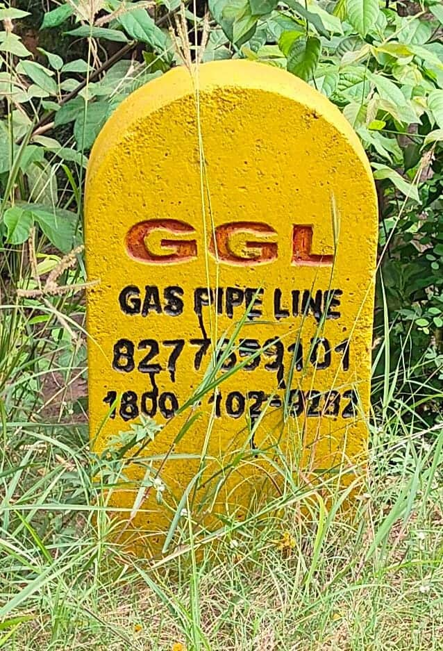
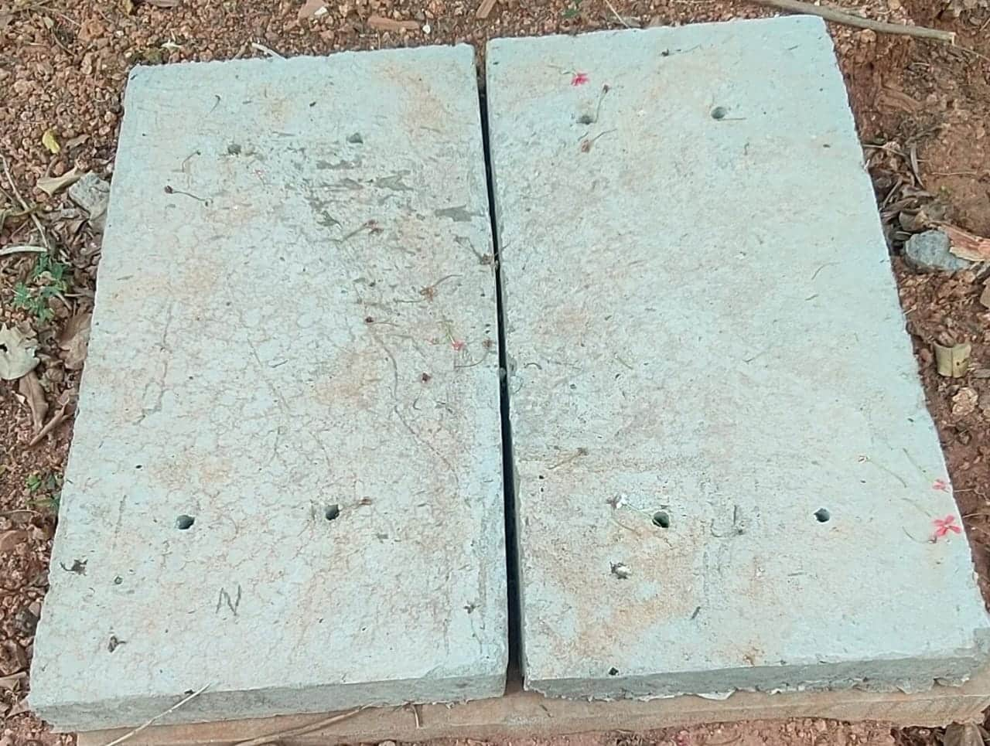
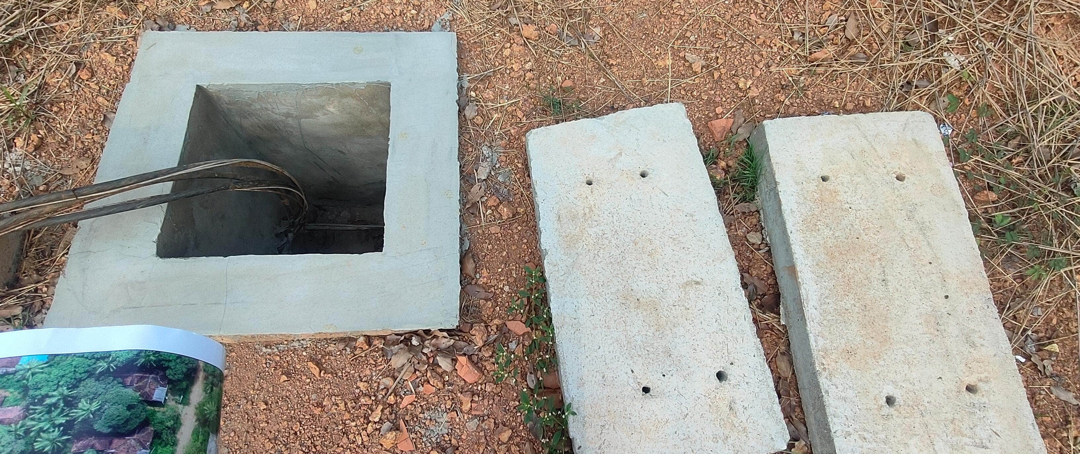
GRID 3
Street CFL Lamps CFL lamp length of 5m = 12 lamps
3 orange pipes ( used for water transport)
Wire Connection inside Concrete box structure (There are 4 such structures)

Slide 11
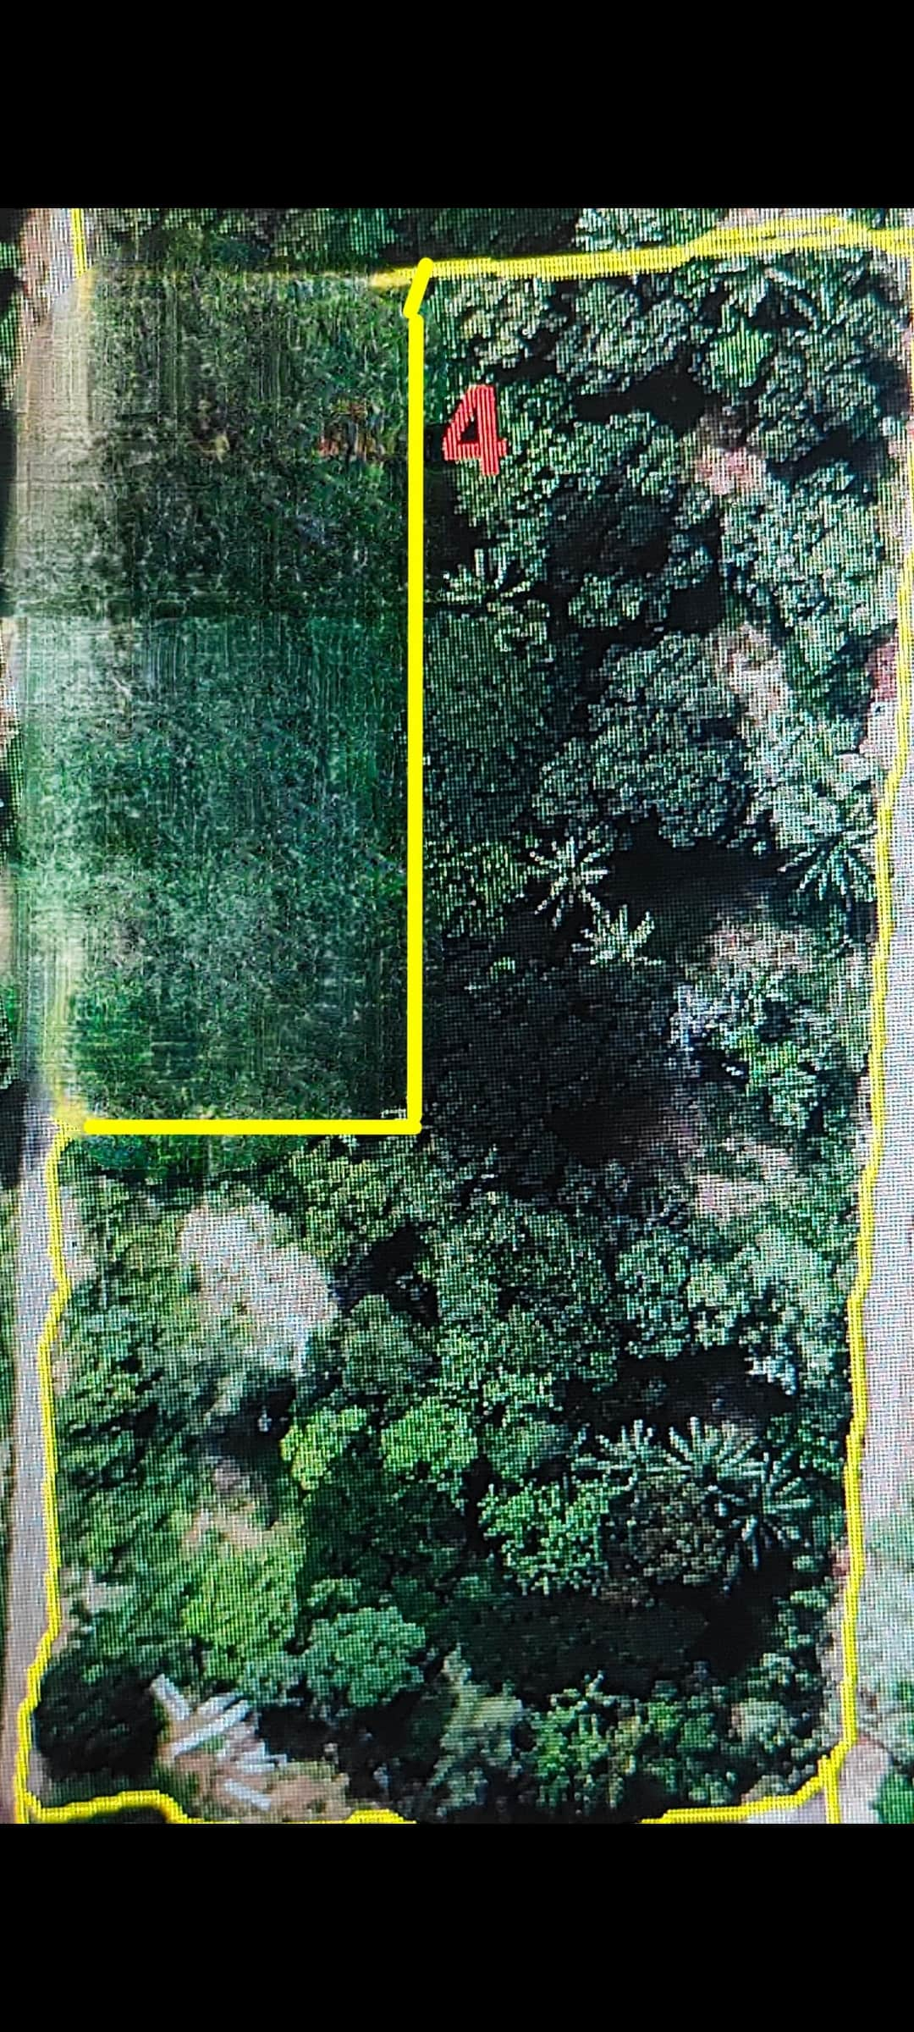
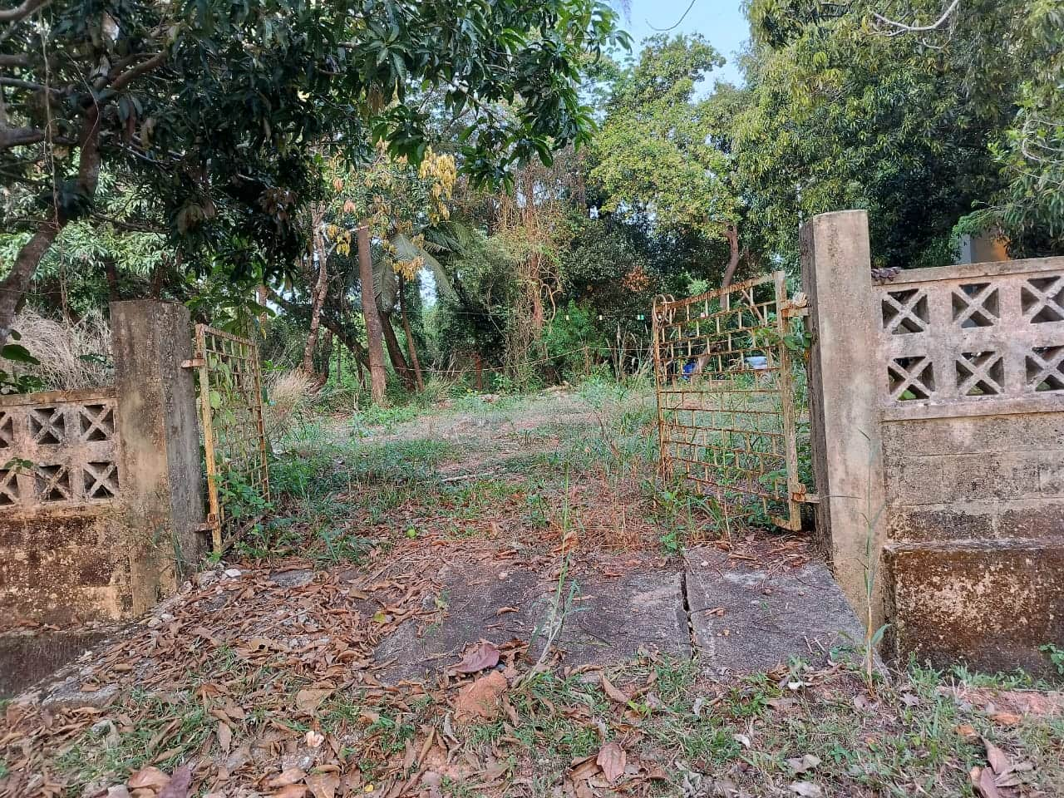
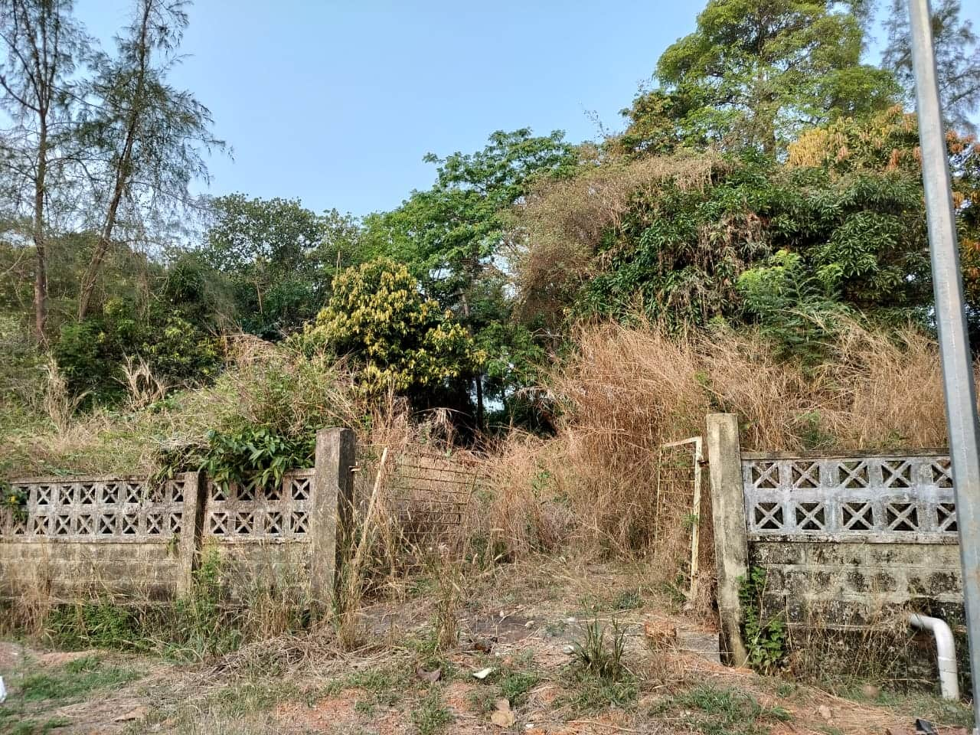
GRID 4
Perimeter = 353.46m
Area = 5416.93 m^2
7 Waste areas in waste there was building earlier, now it demolished
Perimeter = 353.46m
Area = 5416.93 m^2
No.of trees = 200
Other plants = 45

Slide 12
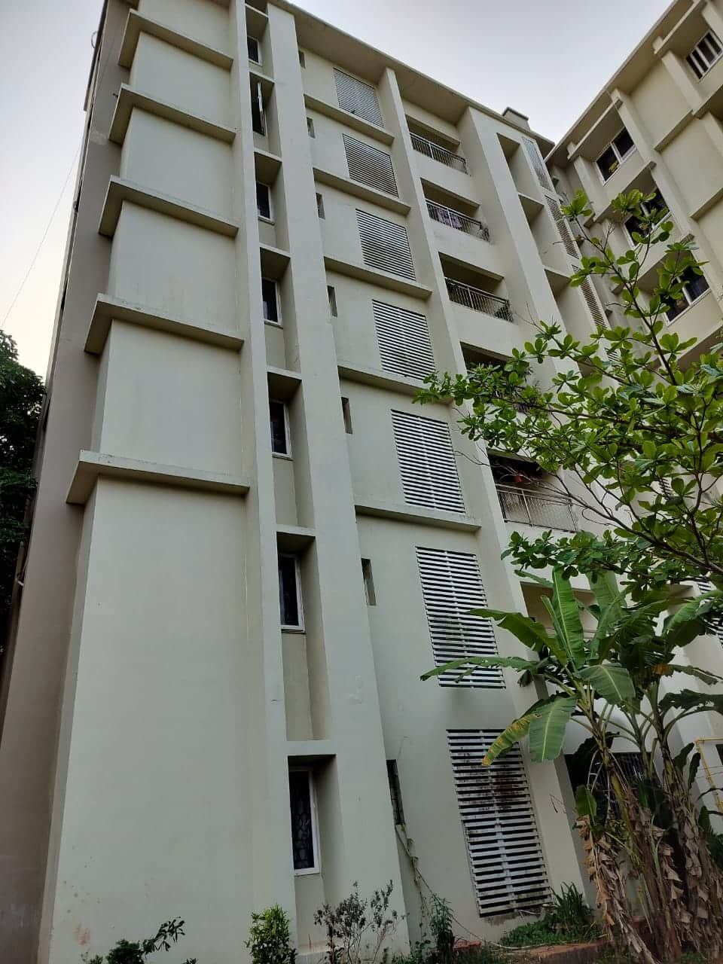
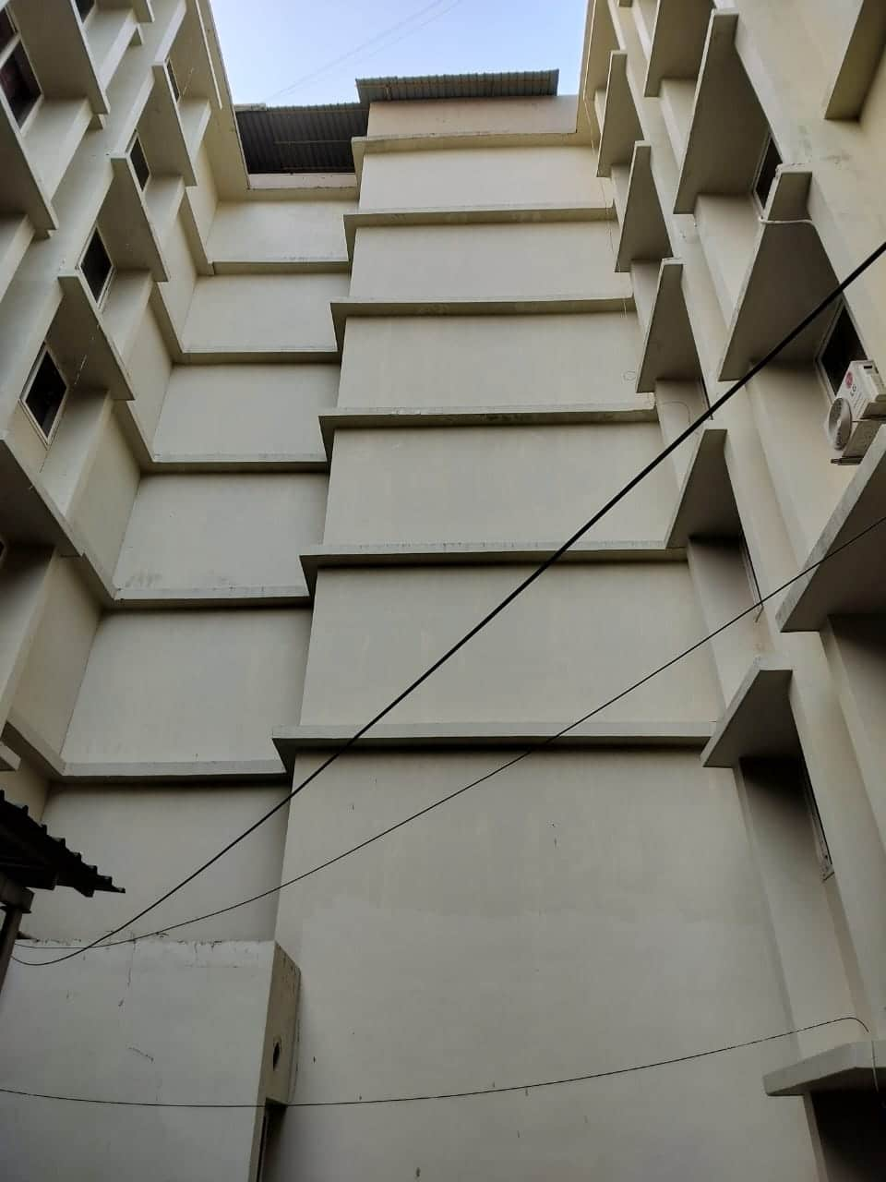
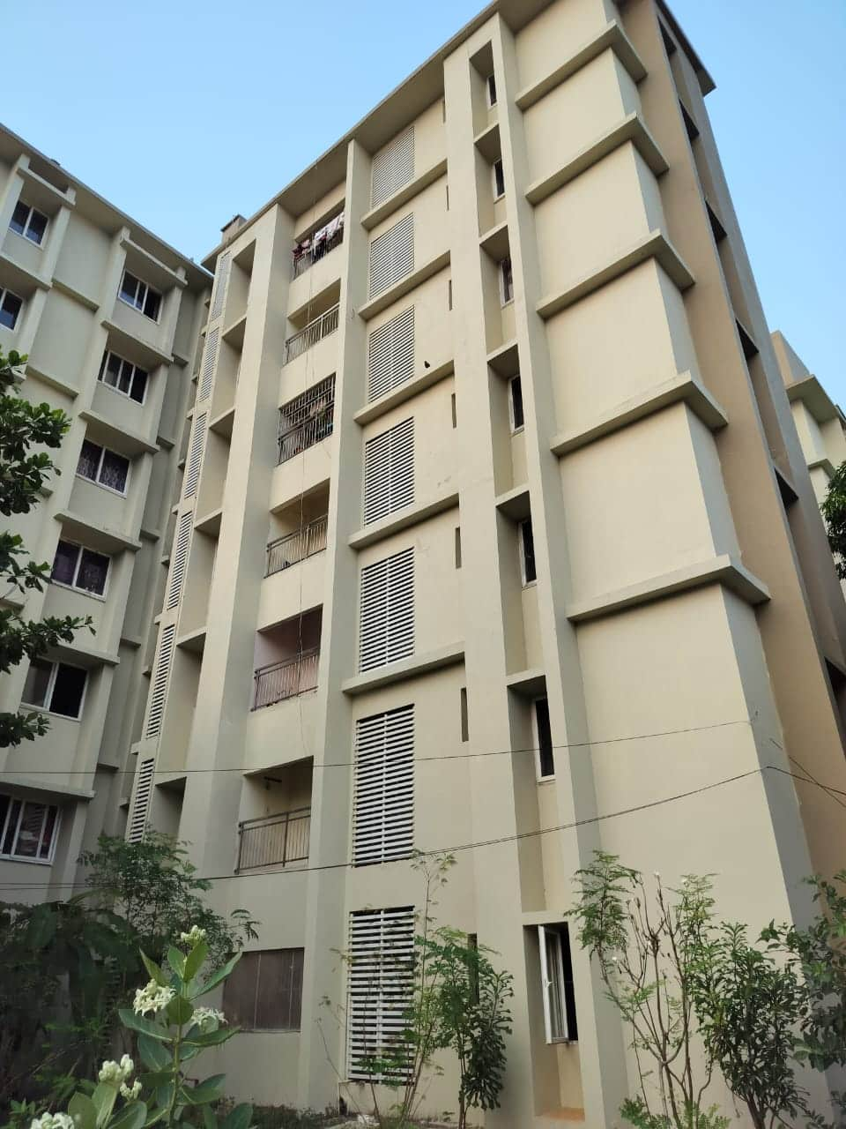
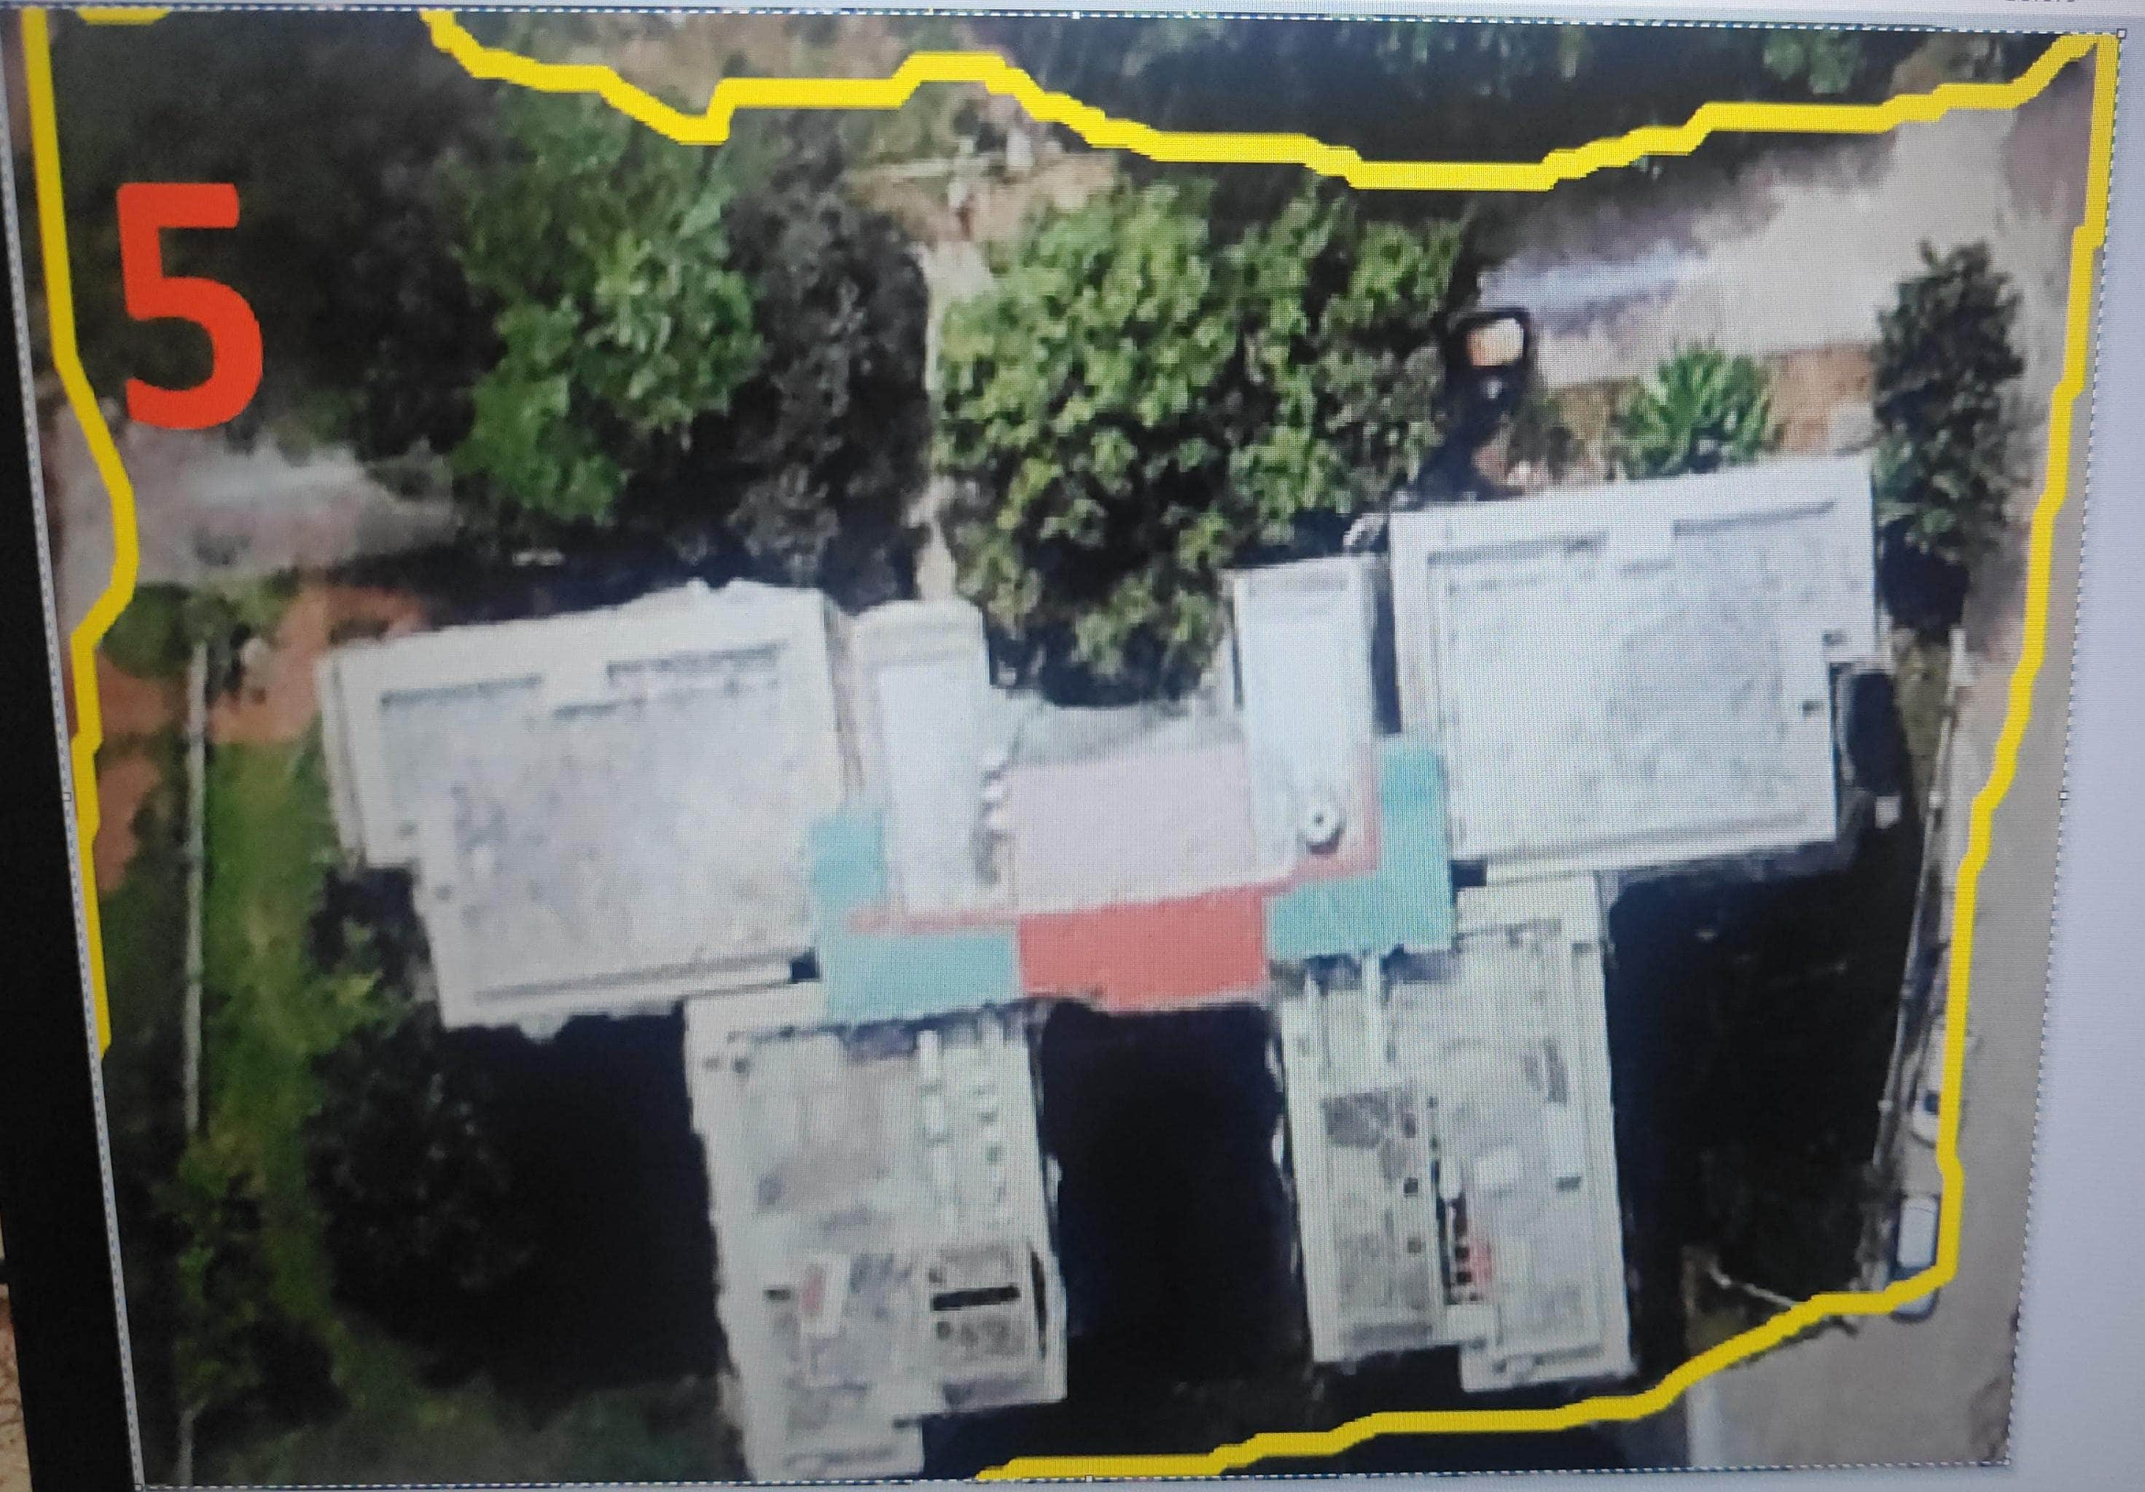
GRID 5
Perimeter = 206.9m
Area = 2582.81 m^2
Building :-
6 apartments
6 parking area in each building
Perimeter = 206.72m
Area = 688.02 m^2
Height = 9.55m
5 street CF lamps

Slide 13
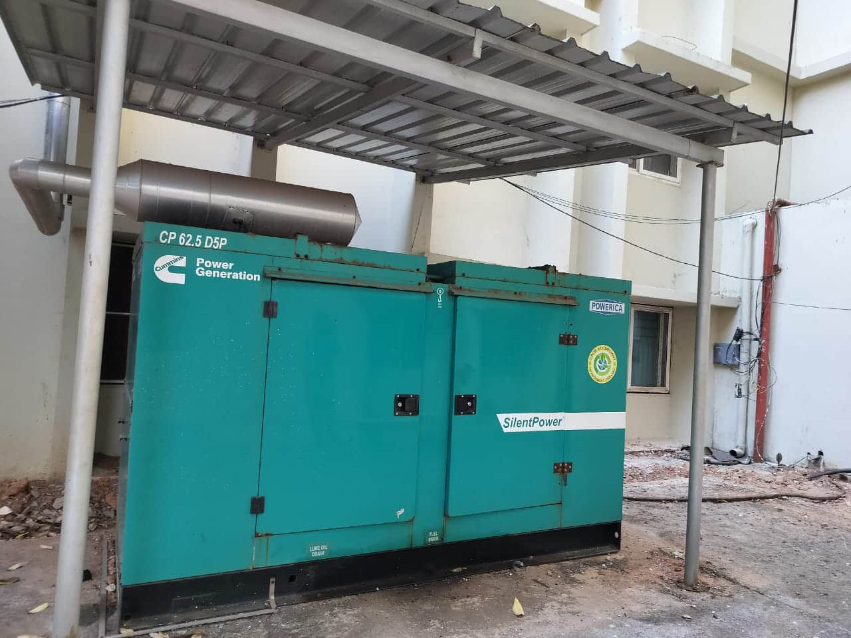
GRID 5
CF lamp length
No.of trees = 8
Road near parking area:-
Length = 5m
Width = 8.03m
Generator :-
Dimension = 2950mm X 1150mm X 1550mm

Slide 14
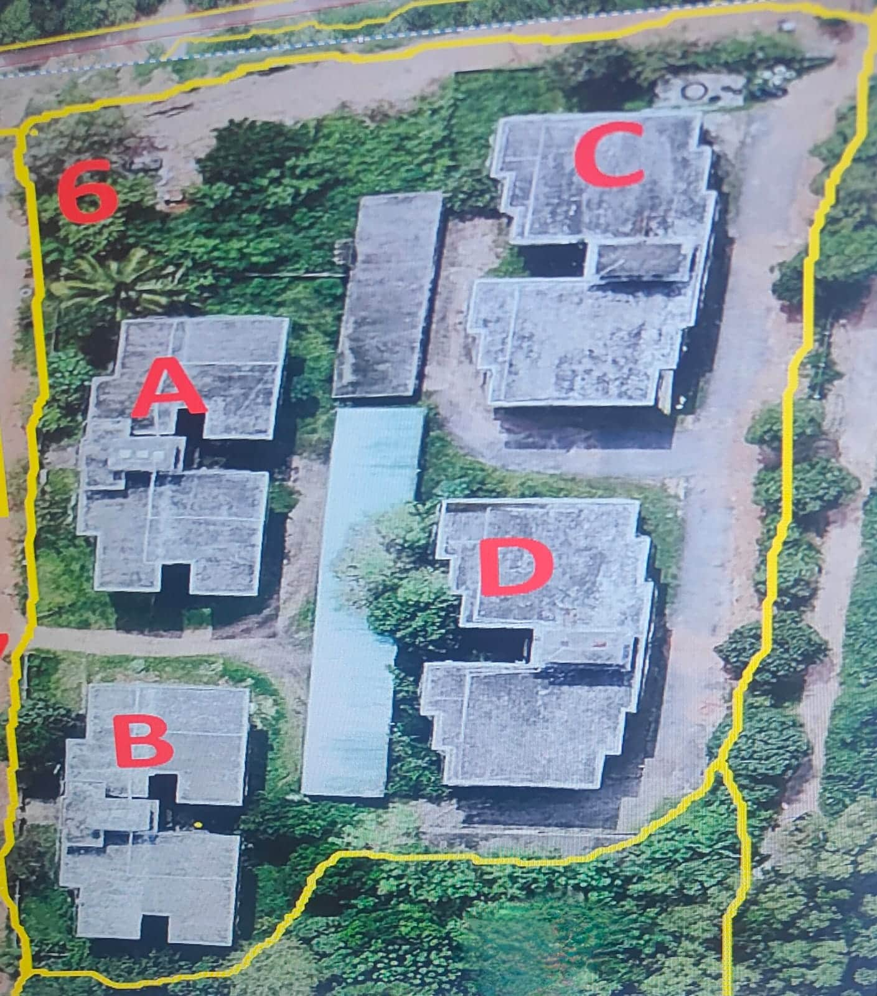
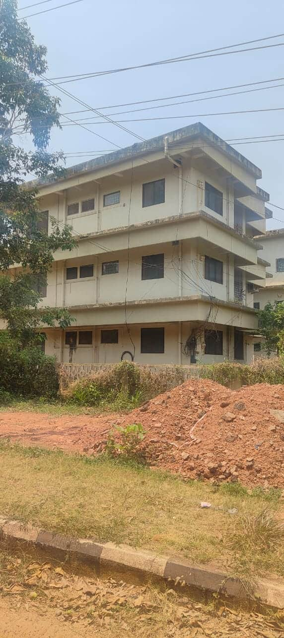
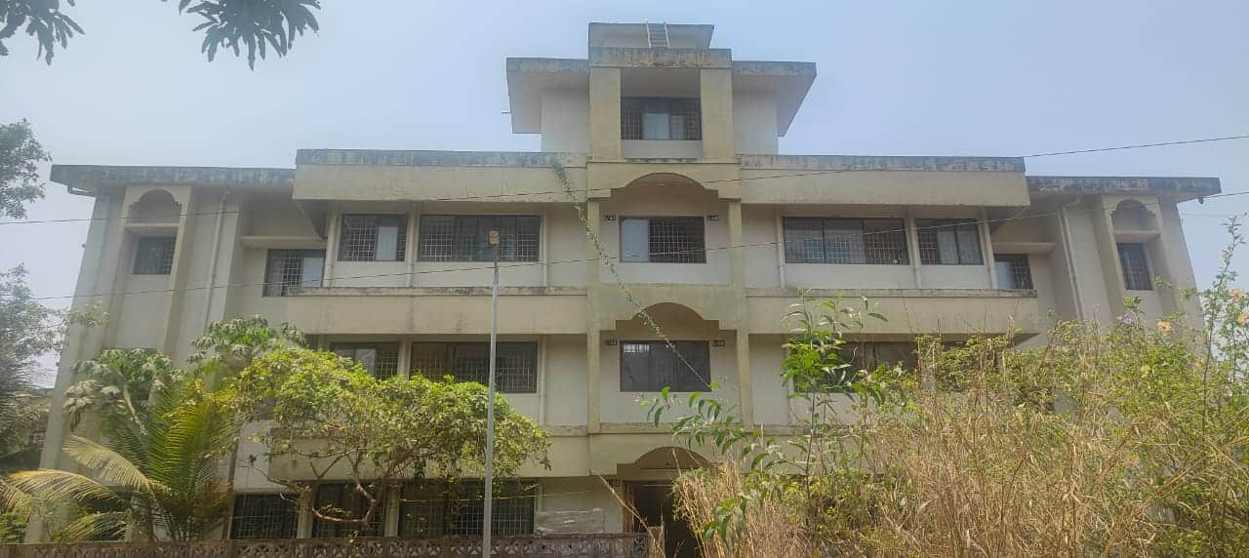
GRID 6
Perimeter :- 320.20 m
Area :- 5459.32 m^2
4 building with 2 apartments
Building A:-
Area = 470.77 m^2
Perimeter = 100.3m
Height = 4m
Building B:-
Area = 409.63 m^2
Perimeter = 113.8m
Height = 5.16m

Slide 15
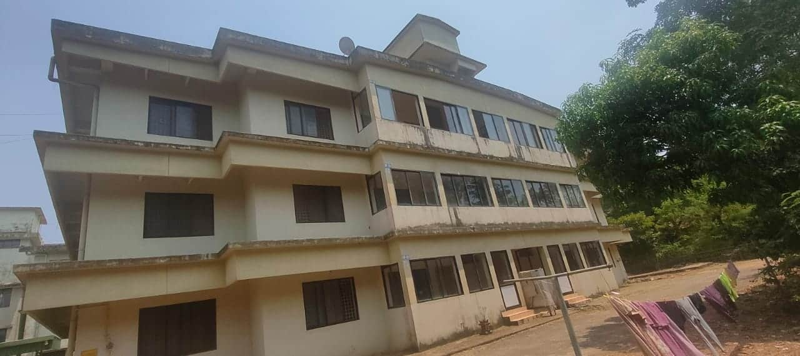
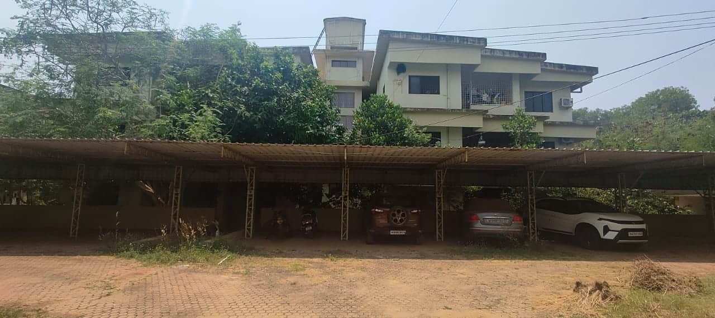
GRID 6
Building C :-
Area = 471.39 m^2
Perimeter = 105.76m
Height =5m
Building D:-
Area = 478.39 m^2
Perimeter = 106.76m
Height = 5.1m
1 fluorescent lamp of length 5m
No.of trees = 35
Other plants = 12
Street lamp control panels

Slide 16
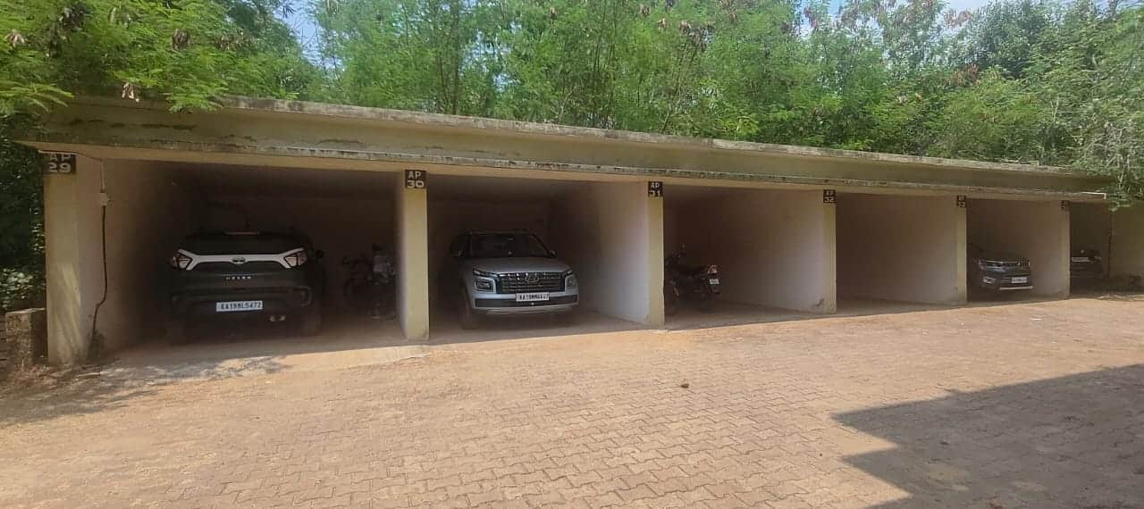
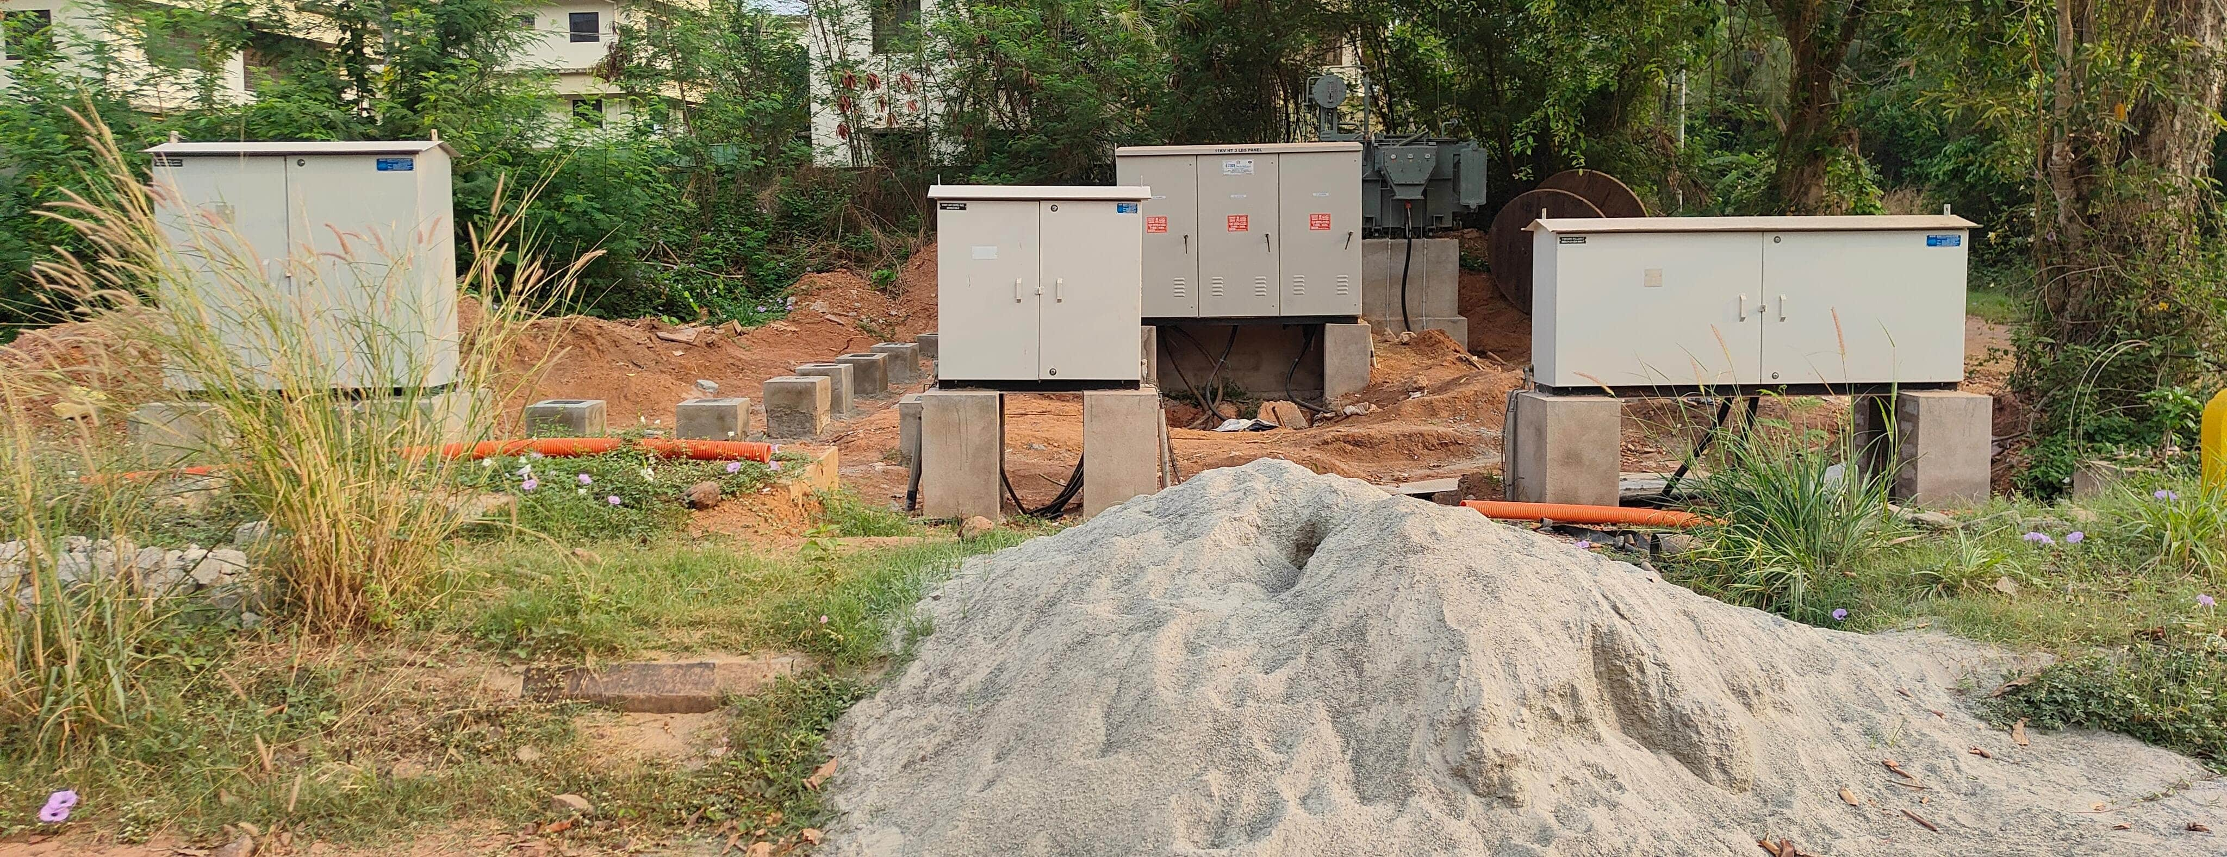
GRID 6
Single lane road:-
Length = 113.816m
Width = 6.41m
16 concrete structures
2 parking areas :-
7 cars can be parked in each
Perimeter = 100.42m
Area = 267.15 m^2
Height = 2.5m

Slide 17
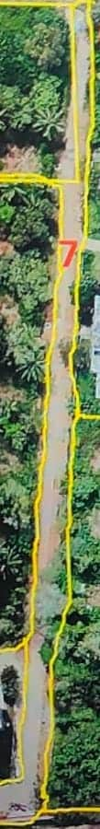
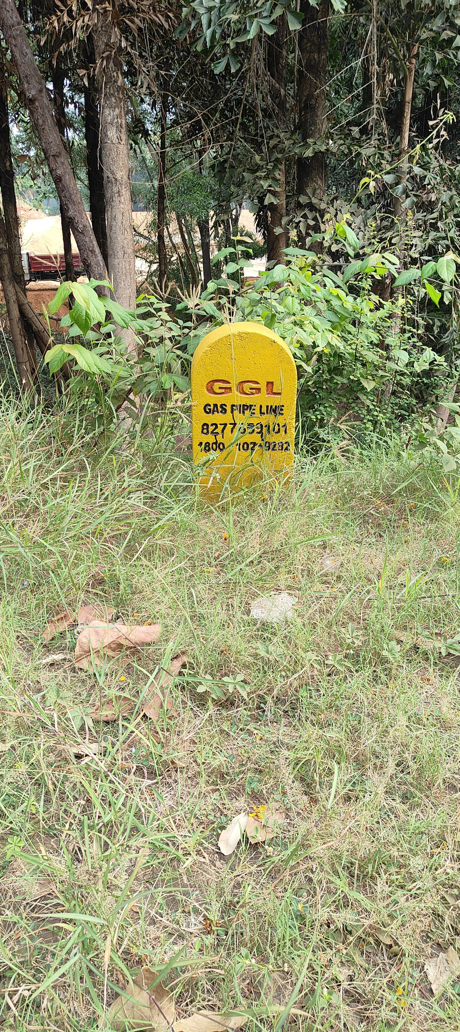
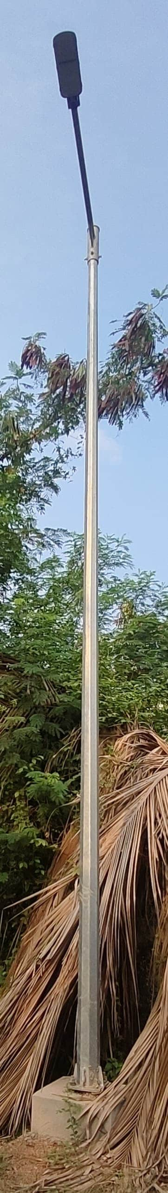
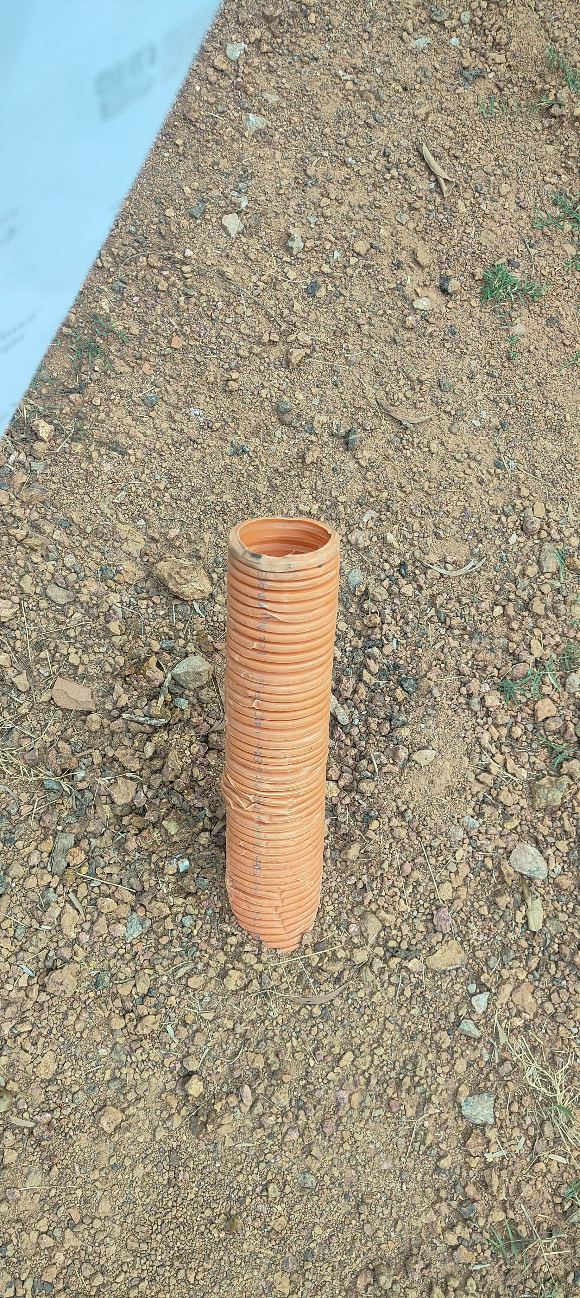
GRID 7
Perimeter = 543.03m
Area = 1962.52 m^2
Sign board with yellow background , black labelled and bordered.
Street compacted fluorescent lamp of length 5m = 10 lamps
Orange pipes = 4

Slide 18
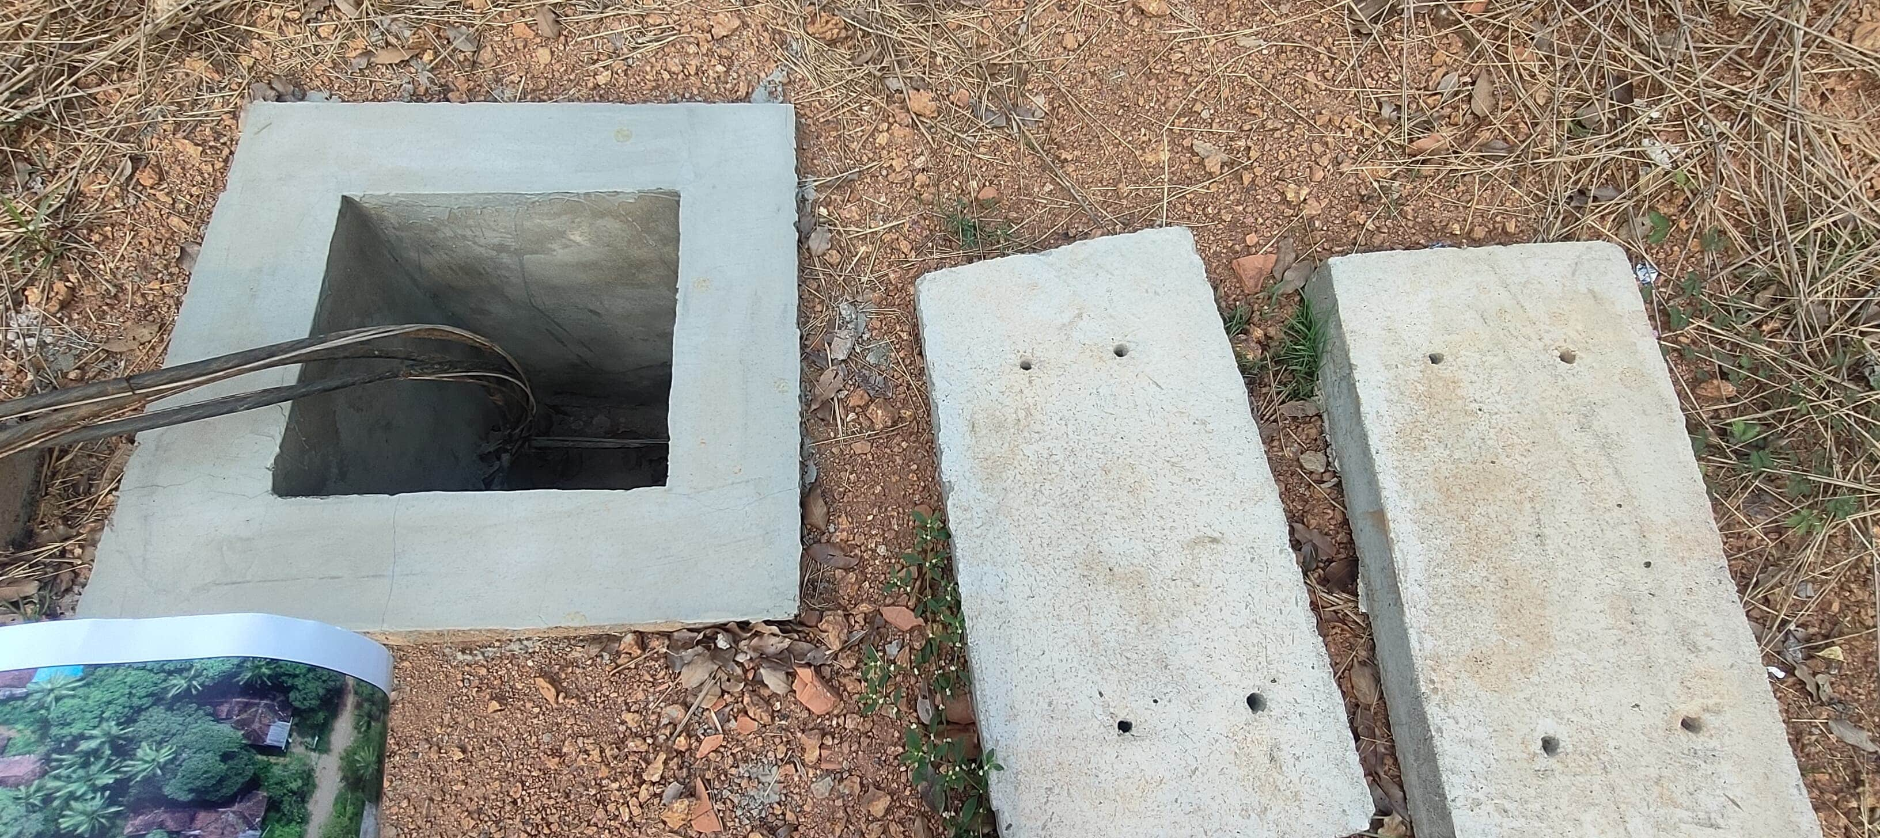
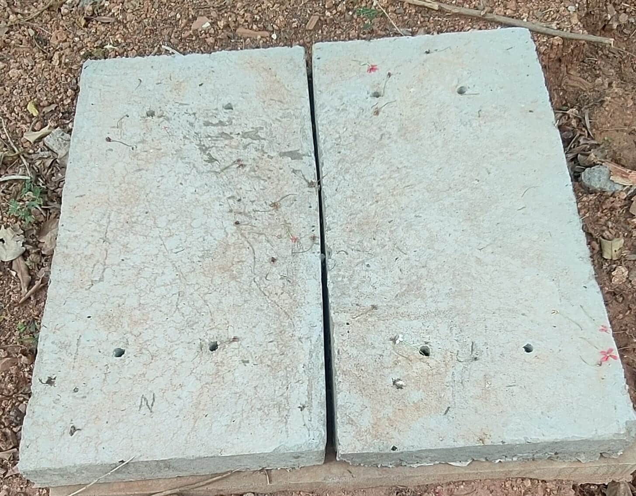
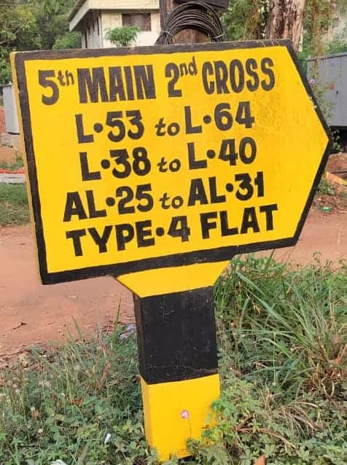
GRID 7
Concrete electricity pole without street lamp=4
Concrete box with wire inside (6 structures)
Gas pipeline = 2
No.of trees = 6
Single lane road:-
Length = 268.42m
Width = 8.68m

Slide 19
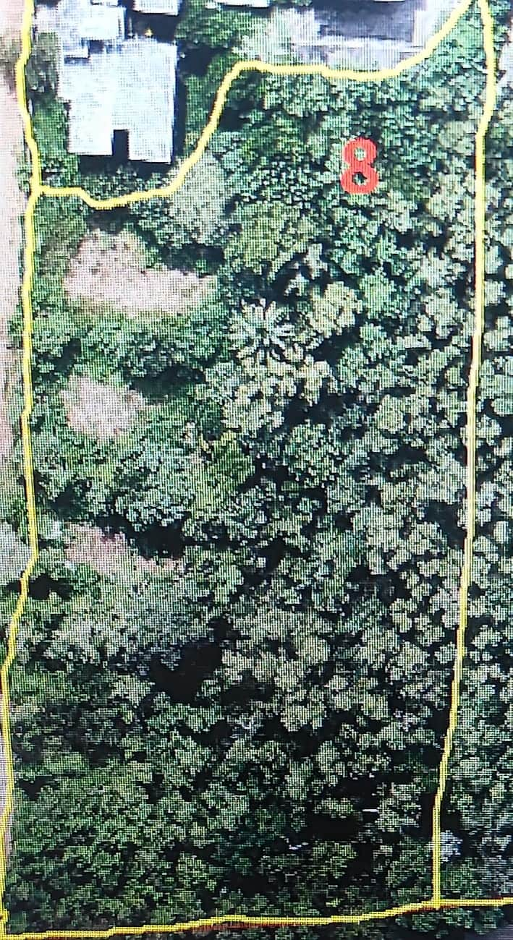
GRID 8
Perimeter = 361.05m
Area = 6357.76 m^2
Waste area:-
Before it was a building area but now it is demolished
No.of trees = 250
Other plants = 45

Slide 20
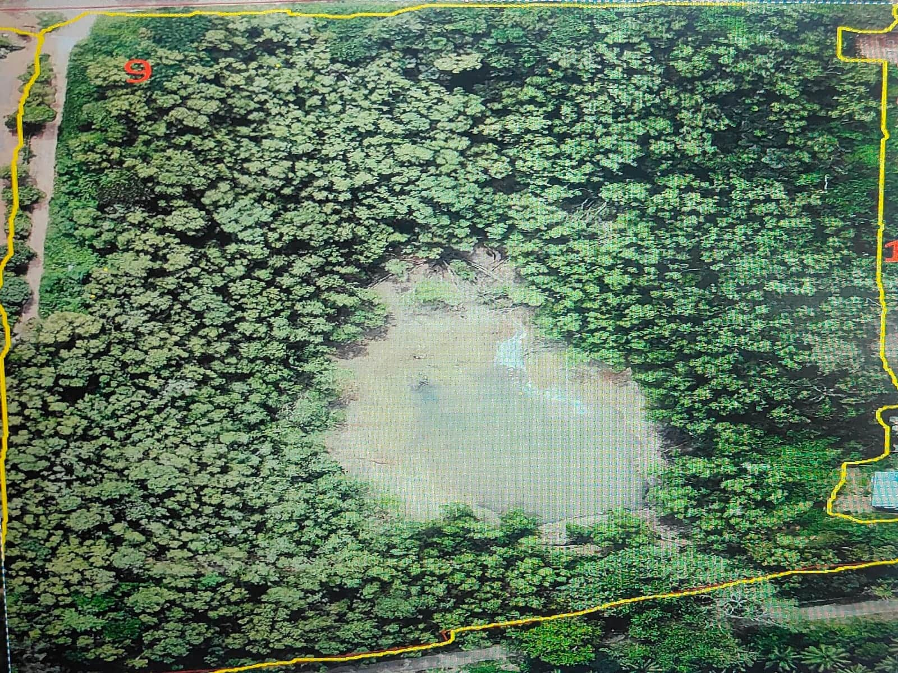
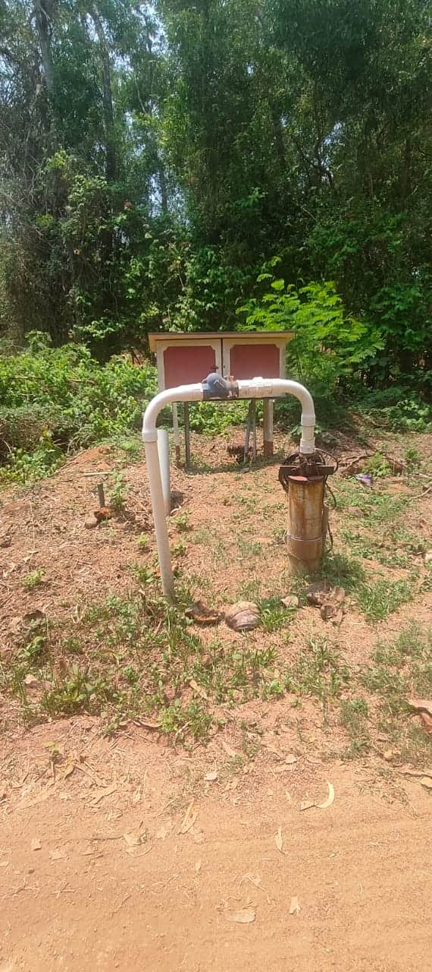
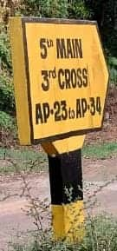
GRID 9
Perimeter = 708.67m
Area = 27431.12 m^2
Sign board with yellow background , black bordered and labelled
Street compacted fluorescent lamp of length 5m = 5 lamps
Concrete electric pole = 5 (one with CF lamp)
More greenery area
One water pump system

Slide 21
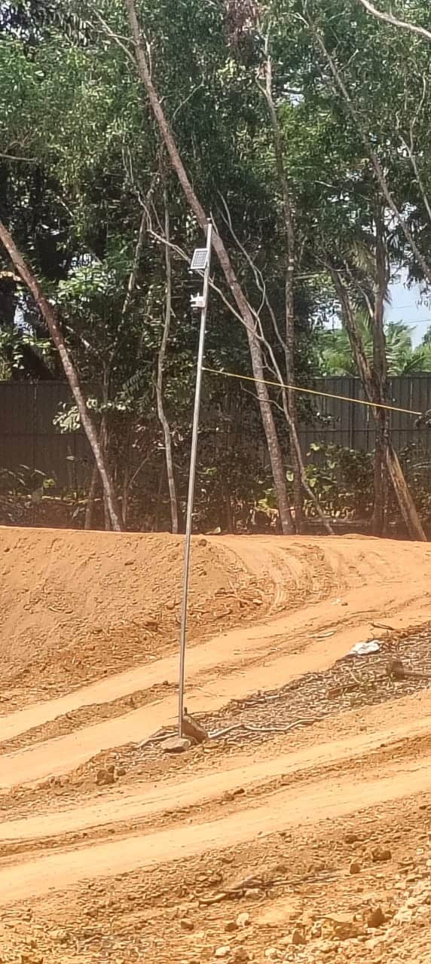
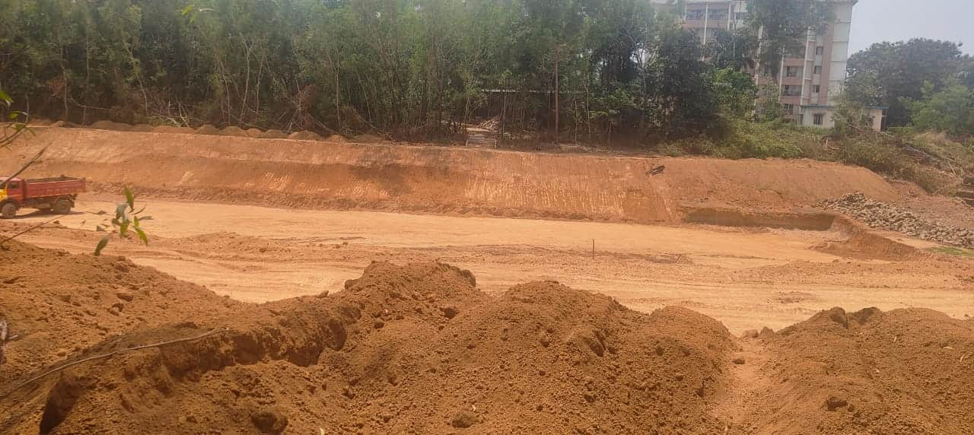

GRID 9
Lake construction area:-
Area = 2210.25 m^2
Perimeter = 201.88m
Depth = 5m
Utility pole with small solar panel of length 5m

Slide 22







GRID 10
Perimeter = 397.05m
Area = 2650.27 m^2
Sign board with yellow background , black bordered and labelled
Street lamp control panels = 4
Concrete box structures = 16
Concrete electric pole = 4
Dustbin = 3

Slide 23



GRID 10
Concrete electric pole with compacted fluorescent lamp = 4
No.of trees = 30
Some wire connections
Sewage Treatment Plant:-
Perimeter = 32.69m
Area = 61.26 m^2
Height = 2.3m

Slide 24



GRID 10
Worker’s place:-
A building before Kannada it was medium school. It is workers place
Perimeter = 79.775m
Area = 148.675 m^2
Height = 3.4m
Single lane road:-
Length = 182.56m
Width = 4.58m

Slide 25




GRID 11
Perimeter = 591.1m
Area = 3495.24 m^2
Electric pole:-
4 solar panels
Length =5.2m
Gas pipe line = 4
Concrete electric poles = 10
4 with compact fluorescent lamp of length 3m
3 compact fluorescent lamp with length of 3m

Slide 26





GRID 11
One orange pipe line
Single lane road:-
Length = 292.76m
Width = 6.23m
1 OFC,NITK FTTH
1 transformer
Footpath:-
Length = 260m
Width = 1.524m

Slide 27
𝓣𝓱𝓪𝓷𝓴 𝔂𝓸𝓾

